Slide 1
YCSB – Open-Source Database Benchmarking Framework
Soma, DBA team
08-29-2024

Slide 2
Agenda
YCSB – Introduction
YCSB – Supported Workloads
YCSB – Supported Databases
References

Slide 3
Yahoo!® Cloud Serving Benchmark - Introduction
YCSB (Yahoo!® Cloud Serving Benchmark) is an industry-standard benchmark for databases and storage engines supporting key-value workloads.
The number of emerging cloud serving systems and the wide range of proposed applications, coupled with a lack of apples to-apples performance comparisons, makes it difficult to understand the for which they are suited. tradeoffs between systems and the workloads.
We define a core set of benchmarks and report results for four widely used systems: Cassandra, HBase, Yahoo!’s PNUTS, and a simple sharded MySQL implementation.
We also hope to foster the development of additional cloud benchmark suites that represent other classes of applications by making our benchmark tool available via open source.
In this regard, a key feature of the YCSB framework/tool is that it is extensible—it supports easy definition of new workloads, in addition to making it easy to benchmark new systems.

Slide 4
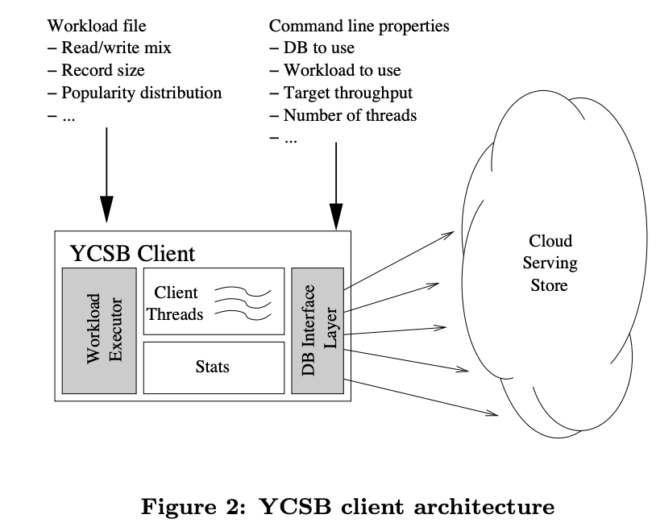
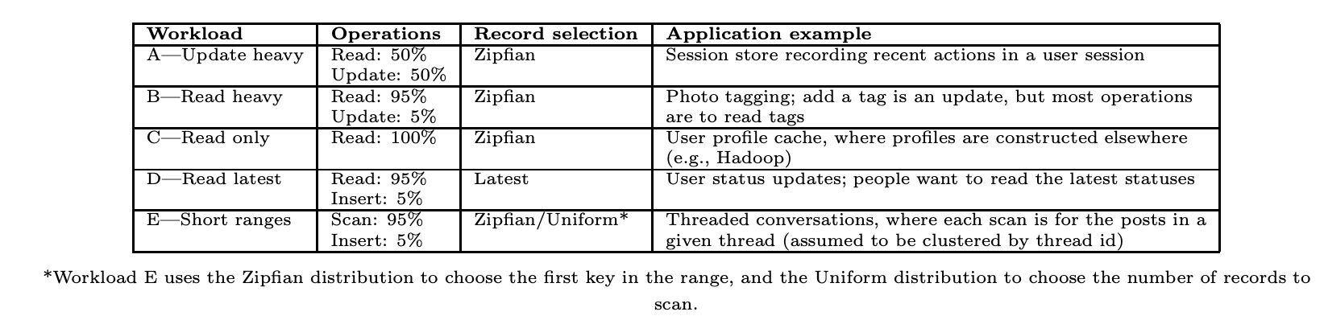
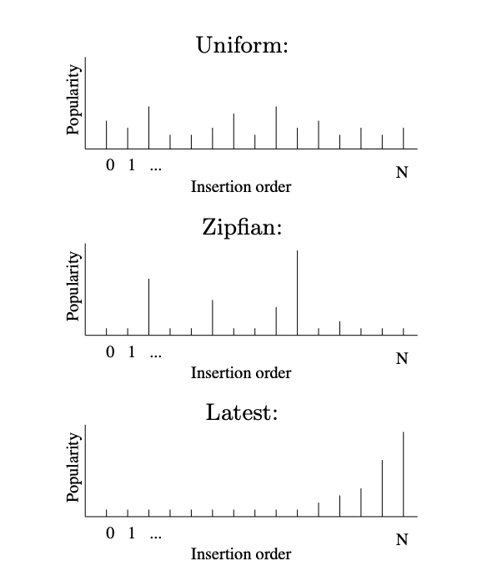
YCSB – Supported Workloads
A: Heavy Updates with a mix of 50/50 reads and writes;
B: Mostly Reads, with a mix of 95/5 reads and writes;
C: Reads only;
D: Inserts of records and reading them right after that;
E: Reads within short ranges;
F: Reads, updates and writing those changes back.

Slide 5
YCSB – Supported Databases
SQL
NoSQL
NewSQL
MariaDB
Microsoft SQL Server
MySQL
PostgreSQL
Oracle RDBMS (Multi-Model)
All databases that support the JDBC driver (version 2.1.1). However, it is often necessary to integrate the special driver separately
Apache Cassandra: Column Family
Apache HBase: Column Family
AWS DynamoDB: Document
Couchbase: Document
Elasticsearch: Document
Google BigTable: Column Family
MongoDB: Document
ScyllaDB: Column Family
Redis: Key/Value
Apache Kudu: Key/Value & Relational
Foundation DB: Key/Value & Relational
Google Cloud Spanner: Key/Value & Relational
Many other NewSQL databases support the JDBC driver just like classic SQL databases and can therefore be integrated just as easily as SQL databases.

Slide 6
References
Github Repo
YCSB Whitepaper
Couchbase - Using YCSB to Benchmark JSON Databases
Storage Performance council
Google Spanner:A NewSQL Journey or Beginning of the End of the NoSQL Era
MongoDB – Using YCSB Benchmark
MongoDB YCSB Git Repo

